Slide 1
Progress Report presentation

Slide 2
Certificate Course
Modern Web Desigh with HTML and CSS (Course No1)
Diploma in Website Development Using HTML and CSS (Course No2)
Web Design Using HTML (Course No3)

Slide 3
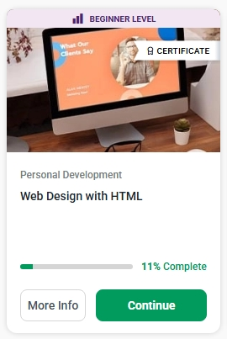
Web design with HtML (3 hours)
Module 1:
Introduction to HTML & HTML Elements
Module 2:
HTML- iframe, Forms and CSS
Module 3:
Course assessment

Slide 4
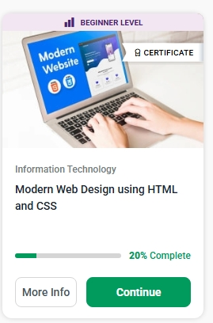
Modern Web Design using html and css (4 hours)
Module 1:
Web Design using HTML.
Module 2:
Styling with CSS
Course Assessment

Slide 5
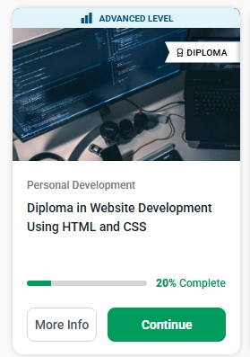
DIPLOMA IN WEBSITE DEVELOPMENT USING HTML AND CSS
MODULE 1:
Introduction to HTML and CSS
Continue Learning
Module 2:
Cascading Style Sheet
Continue Learning
Module 3:
Diploma in Website Development using HTML and CSS - First Assessment
Continue Learning
Module 4:
HTML Header and Footer

Slide 6
CERTIFICATION PROGRESS
REPORT

Slide 7
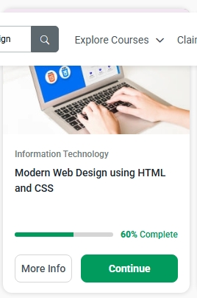
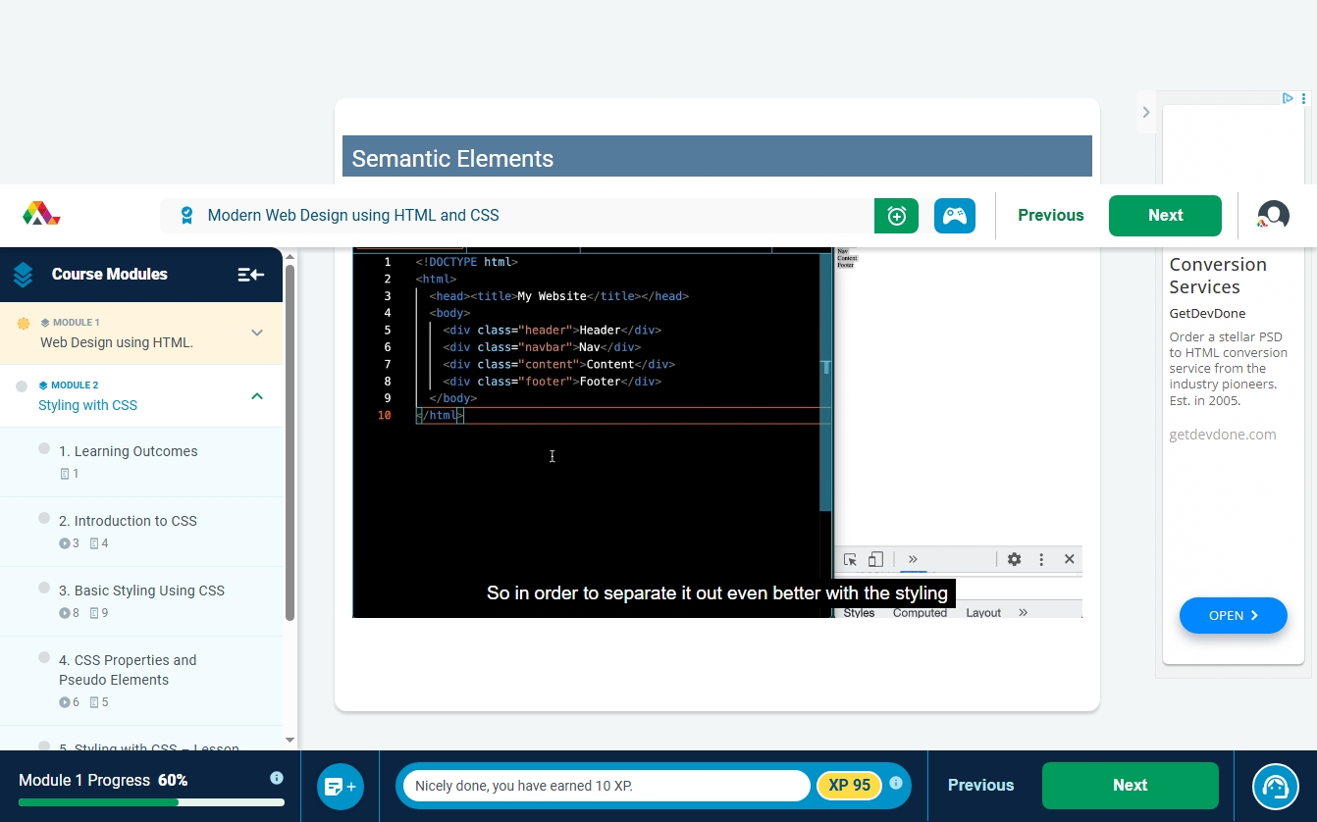

Slide 8
Thank you
Aruzhan Batyrbay
+77772117063
aruzhanbatyrbay2007@gmail.com

